Slide 1
DO NOW
STANDARD
OBJECTIVES
CCSS.ELA-LITERACY.W.9-10.3.D Use precise words and phrases, telling details, and sensory language to convey a vivid picture of the experiences, events, setting, and/or characters.
Strategically revise Personal Narratives by incorporating figurative language into student writing.

Slide 2
AGENDA
Announcements
Personal Narrative Activity
Exit Ticket

Slide 3
HOMEWORK
DUE NEXT CLASS:
Comprehension Questions for “Superman and Me”
Figurative Language Revision Activity
Please bring in your Personal Narrative Object (if you can)
*Note: If you did not have your Personal Narrative in class, you are STILL RESPONSIBLE for the 2 assignments above

Slide 4
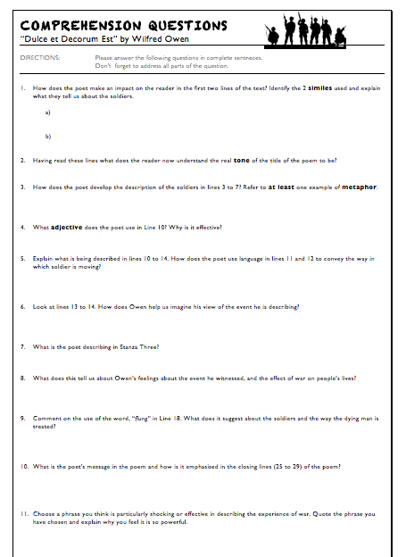
UPDATE: UNIT 1 TABLE OF CONTENTS!
MATERIALS:
Pen/Pencil
Rough Draft of PN
Highlighter
Handout from last class
SETTING UP
PG #
Personal Narrative Table of Contents
14
Project Rubric Analysis
15
W.10.3A – Engage/Orient
16
RL.10.5 – Analyzing Author’s Structure
17
Plot Diagram
18
RL.10.5 – Structure Notes
19-20
Story Starters: Narrative
21
Figurative Language
21
Tone & Mood
22
Dead Words

Slide 5
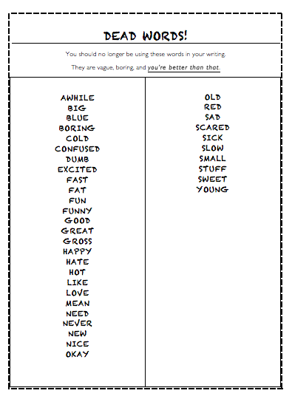
ACTIVITY DIRECTIONS
Glue insert into E-Book

Slide 6
PROJECT PROMPT:
Write a narrative in which you describe a time when you examined something very closely. You might discuss an object in the natural world, an author’s use of language, or a picture. Whatever you choose to discuss, describe the occasion so vividly that your readers will feel they were right there with you.

Slide 7
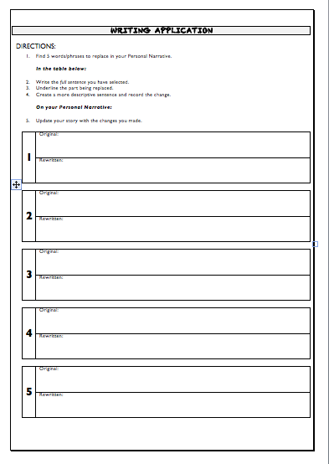
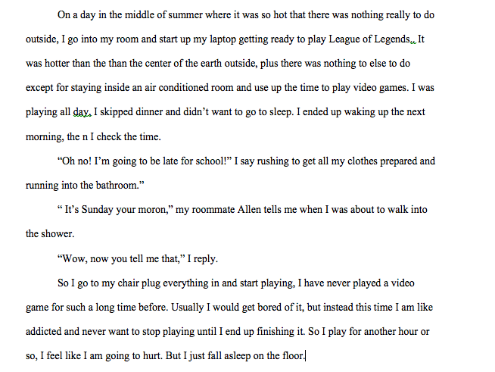
PN & FIGURATIVE LANGUAGE
PERSONAL NARRATIVE: Draft
(iPad or paper)
HANDOUT

Slide 8
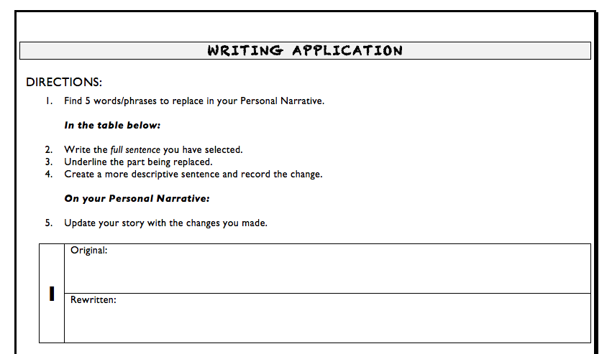
PN WRITING APPLICATION

Slide 9
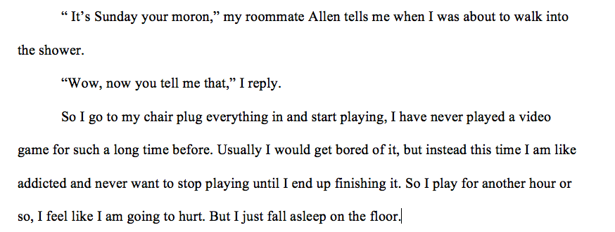
EXAMPLE

Slide 10
CLASS EXAMPLE
So I get to my chair, plug everything in, and start playing.
Then, I raced to my chair, inserted my Borderlands 2 disc, activated my controllers, and began my infamous face-off with Simon.

Slide 11
PN WRITING APPLICATION

Slide 12
EXIT TICKET: ON SCRATCH PAPER
IDENTIFY the DEAD WORD(s) in the example sentences.
REVISE with a more descriptive word or phrase.
When I get to the mall I see them there and they look happy all as a group again.
The ice cream tasted sweet.
The boy did a bad job explaining the directions.
The girl was very sick.

