Slide 1
DO NOW
STANDARD
OBJECTIVES
Determine the meaning of words and phrases as they are used in the text, including figurative and connotative meanings; analyze the cumulative impact of specific word choices on meaning and tone
Analyze the purpose of figurative language in “A Mark on the Wall” by successfully participating in class discussion.

Slide 2
AGENDA
Announcements
Discussion Prep
Discussion
Exit Ticket
PN Activity (?)

Slide 3
HOMEWORK
DUE NEXT CLASS:
Comprehension Questions for
“A Hunger Artist”
Please bring in your Personal Narrative Object (if you can)

Slide 4
Discussion Prep: GUIDING QUESTION
What was Woolf’s purpose/intent for writing “A Mark on the Wall”? Why does she focus so heavily on the mark and its description?

Slide 5
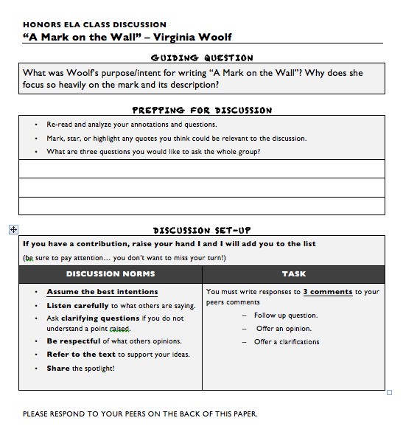
Prepping for Discussion
Re-read and analyze your annotations and questions.
What are three questions you would like to ask the whole group?

Slide 6
Period 2: Student Questions
You need at least ONE analytical discussion question.
Suggestions for student questions:
What can we predict from…?
What might happen if…?
What do you think about…?
What is most important…?
What reaction was Woolf seeking when…?
What does Woolf mean when she says, “___”?
Why do you think Woolf chose to include…?
What does this writing style tell us about…?

Slide 7
Discussion Set-Up
If you have a contribution, raise your hand I and I will add you to the list (be sure to pay attention… you don’t want to miss your turn!)
DISCUSSION NORMS
Assume the best intentions Listen carefully to what others are saying. Ask clarifying questions if you do not understand a point raised. Be respectful of what others opinions. Refer to the text to support your ideas. Share the spotlight!

Slide 8
STUDENT RESPONSES
You must write responses to 3 comments to your peers comments
.
Follow up question.
Offer an opinion.
Offer a clarifications

Slide 9
EXIT TICKET!
What was Woolf’s purpose/intent for writing “A Mark on the Wall”? Why does she focus so heavily on the mark and its description?
** Leave one appreciation for a group member on your exit ticket

