Slide 1
DO NOW
STANDARD
OBJECTIVES
Determine the meaning of words and phrases as they are used in the text, including figurative and connotative meanings; analyze the cumulative impact of specific word choices on meaning and tone
Use graphic organizers to thoughtfully analyze text for the effect of an author’s choice of words.
Create a CEL paragraph that insightfully argues how word choice affects tone and mood.

Slide 2
AGENDA
AGENDA
NOTES: Tone & Mood
ANALYSIS ACTIVITY: Owen’s Letters
CEL PARAGRAPH
WRITING APPLICATION: Precise Words in your PN
EXIT TICKET

Slide 3
ANNOUNCEMENTS
Headphones are for CEL paragraphs & Exit Tickets

Slide 4
HOMEWORK
DUE WEDS:
Close-Read “Superman and Me”
By,
Sherman Alexie
DUE THURS/FRI:
Comprehension Questions
(Hand-out on Weds)

Slide 5
REVIEW
ENGAGE & ORIENT
“Shooting an Elephant”
Grabbing and holding your attention Introducing you to the story
STRUCTURE & Creating SUSPENSE
“Learning to Read”
Chronological/Linear Reverse Chronological Non-Linear In Media Res Epistolary
FIGURATIVE LANGUAGE
Owen’s Letters
Metaphor Simile Personification Hyperbole

Slide 6
UPDATE: UNIT 1 TABLE OF CONTENTS!
SETTING UP
MATERIALS:
Pen/Pencil
“Owen’s Letters”
Highlighter
iPad or Paper
PG #
Personal Narrative Table of Contents
14
Project Rubric Analysis
15
W.10.3A – Engage/Orient
16
RL.10.5 – Analyzing Author’s Structure
17
Plot Diagram
18
RL.10.5 – Structure Notes
19-20
Story Starters: Narrative
21
Figurative Language
21
Tone & Mood

Slide 7
FIGURATIVE LANGUAGE NOTES
08/21
Figurative Language is…
RL.10.4
Describing something by comparing it to something else.
SIMILE:
Comparison using “like” or “as”
METAPHOR:
Comparison NOT using “like”
HYPERBOLE:
Comparison that exaggerates
PERSONIFICATION:
Giving an object human characteristics
08/25
TONE & MOOD

Slide 8
08/25
TONE & MOOD
RL.10.4
Guiding Question: How does Wilfred Owen use word choice, tone, and mood to express his opinion of government and/or war?
Tone: The attitude of the NARRATOR/AUTHOR towards the subject
Mood: The general feeling created (for the READER) by the text

Slide 9
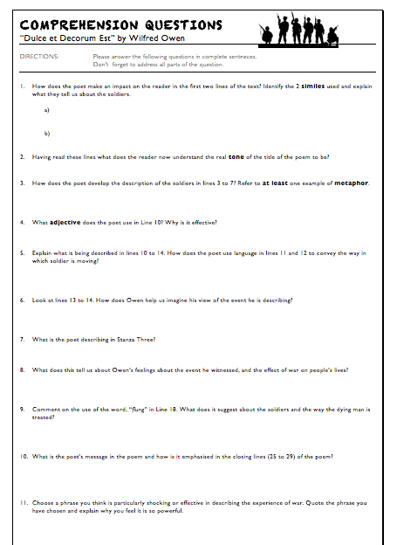
ANALYSIS ACTIVITY Step 1: Reading Questions
Directions:
To help you with your CEL later…
Work with your elbow partner to answer the comprehension questions.

Slide 10
ANALYSIS ACTIVITY Step 2: Tone & Mood
DIRECTIONS | Re-read the specific passage Highlight or underline sentences that show the author using figurative language to reflect their tone and create mood Use your graphic organizer to collect and analyze your selected examples

Slide 11
ANALYSIS ACTIVITY Step 2: Tone & Mood Example
DIRECTIONS | Re-read the specific passage Highlight or underline sentences that show the author using figurative language to reflect their tone and create mood Create a graphic organizer on the back of your reading packet to collect and analyze your selected examples
TONE Resentful
QUOTE:
“Men marched asleep. Many had lost their boots / but limped on, blood-shod.”
ANALYSIS:
With this example, Owen creates a tone of true resentment towards the army and the government. We can imagine that these soldiers are so ill-taken care of that they are forced to endure excruciating pain and weariness even though they are sacrificing their lives for their country.

Slide 12
DIRECTIONS | Re-read the specific passage Highlight or underline sentences that show the author using figurative language to reflect their tone and create mood Create a graphic organizer on the back of your reading packet to collect and analyze your selected examples
TONE: | “Men marched asleep. Many had lost their boots / but limped on, blood-shod.” | With this example, Owen creates a tone of true resentment towards the army and the government. We can imagine that these soldiers are so ill-taken care of that they are forced to endure excruciating pain and weariness even though they are sacrificing their lives for their country.
MOOD: Hopeless-ness | “Knock-kneed, coughing like hags, we cursed through sludge.” | By using words like “hags” and “cursed”, Owen creates a mood of hopelessness. We can imagine soldiers who are so tired from the battlefield that they are wandering around like sick, embittered, elderly men. They are so exhausted that they cough and curse as they march to their oblivion.

Slide 13
EXAMPLE CEL PARAGRAPH
Guiding Question: How does Wilfred Owen use word choice, tone, and mood to express his opinion of government and/or war?
Wilfred Owen uses simile to create a resentful tone towards the military and the idea war. At the beginning of the poem, Owen begins to describes the soldiers’ physical appearance and how they looked marching through the battle zones. He haunts us by stating, “knock-kneed, coughing like hags, we cursed through sludge.” By using this simile, Owen is able to effectively describe the hopeless depression most of the soldiers felt during World War I. When he uses the words “hags” and “cursed” we are able to visualize soldiers who are so tired from the battlefield that they are wandering around like sick, embittered, elderly men. They are in such poor condition emotionally and physically that they “cough” and “curse” as they march to their oblivion. Through this depiction we feel extreme pity for the soldiers and truly understand the disheartening mood created by this moment.

Slide 14
CLAIM | What type of figurative language is being used? Are you going to discuss tone or mood? | Wilfred Owen uses metaphor to create a __________ tone/mood towards the idea of war.
EVIDENCE | What does your reader need to understand about the poem or Wilfred Owen in order to understand your quote? | In the second stanza, Owen explains _____________. He then highlights his opinion when he states that “________.”
LINK | What is the effect of the words on our perspective as the reader? How does the language make us react? What is our understanding of Wilfred’s experience and opinion BECAUSE of the words being used? | The effect of this description on the reader is… The reader is able to feel… We then understand that Wilfred feels __________ because __________.

Slide 15
5 MINUTE BREAK

Slide 16
PROJECT PROMPT:
Write a narrative in which you describe a time when you examined something very closely. You might discuss an object in the natural world, an author’s use of language, or a picture. Whatever you choose to discuss, describe the occasion so vividly that your readers will feel they were right there with you.

Slide 17
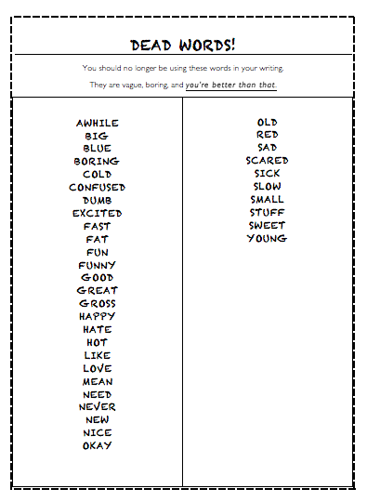
ACTIVITY DIRECTIONS
Glue insert into e-book

Slide 18
CLASS EXAMPLE
So I get to my chair, plug everything in, and start playing.
Then, I raced to my chair, inserted my Borderlands 2 disc, activated my controllers, and began my infamous face-off with Simon.

Slide 19
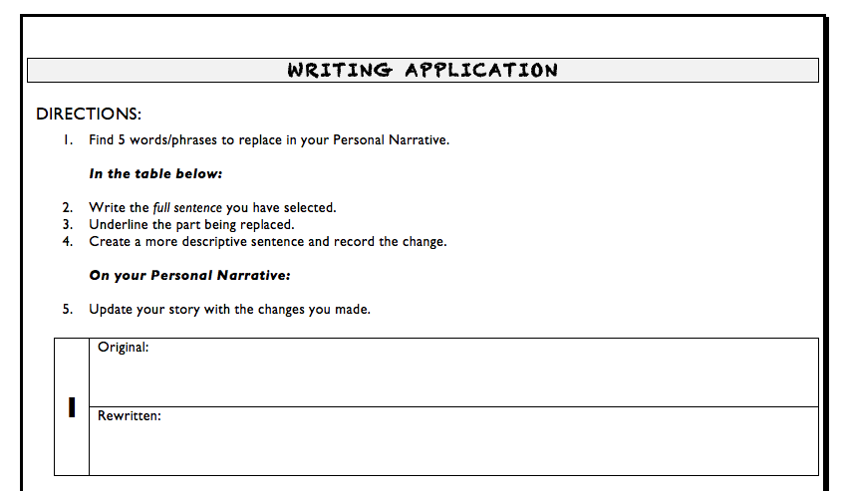
PN WRITING APPLICATION

Slide 20
EXIT TICKET
Comprehension Questions
CEL Paragraph
Writing Application Activity

