Slide 1
DO NOW
STANDARD
OBJECTIVE
W.10.3D
Use precise words and phrases, telling details, and sensory language to convey a vivid picture of the experiences, events, setting, and/or characters.
IWBAT collaborate in small groups to create an interesting visual presentation that will offer alternatives for a selected dead word.

Slide 2
AGENDA
BUSINESS/ANNOUNCEMENTS
LIVING WORDS ACTIVITY
------- SECOND HOUR -------
PEARSON TIMED WRITING & DIAGNOSTIC

Slide 3
ANNOUNCEMENTS
5th Period: I need your paragraphs from yesterday
1st Period: I need your peer edits sheet and rough draft

Slide 4
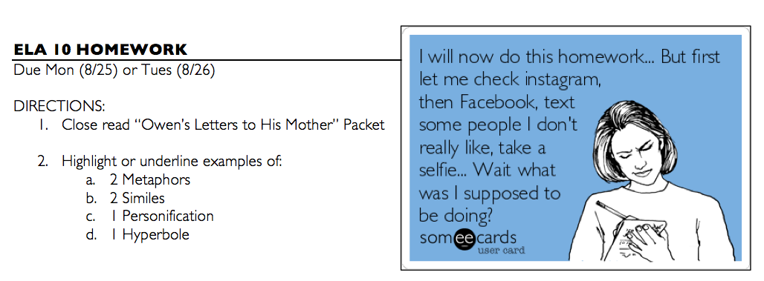
HOMEWORK
“A Mark on the Wall” by Virginia Woolf

Slide 5
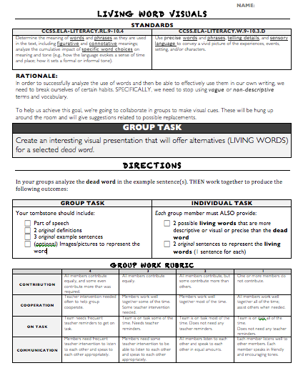
ACTIVITY
SWITCH TO ELMO FOR OVERVIEW AND DIRECTIONS

Slide 6
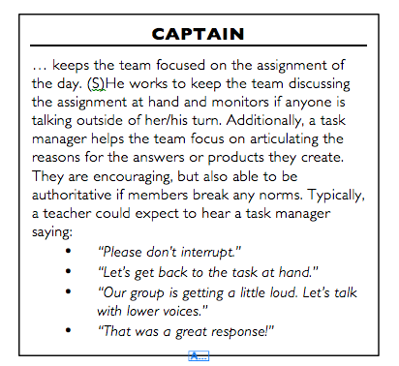
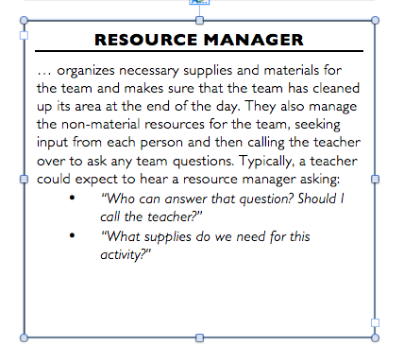
GROUPS / ROLES (pg: )
Same groups as your peer-editing activity.

Slide 7
Rotten, run down, nauseated, bedridden, suffering, ailing, debilitated, hospitalized, weak
“She felt bad.”
Sick
Sad
Apologetic
Attritional, repentant, penitent, shamefaced, contrite, compunctious, conscience-stricken
Morose, depressed, bitter, gloomy, cheerless, blue, despairing, hurting, pensive, wistful

Slide 8
TESTING SET-UP
You Need:
Pencil
Optional: Highlighter, Colored Pencils, Annotation Tools
Divider Folder
Please place folders between you and your partner

Slide 9
TESTING OVERVIEW
READING COMP
WRITING 1 (#9)
WRITING 2 (#10)
Close read the text
Answer the multiple choice
Write a summary (length is your decision)
Summary is about the attached
At least 1 CELEL paragraph
DURING TEST
AFTER TEST
Focus on your own work
Absolutely silent
When you are finished, move on to the “After Test” work
At this point you may listen to music… but ONLY if you did your HW… I’m checking.
Turn in to Ms. L
Start HW
---- OR ----
Continue working on Personal Narrative

