Slide 1
TO DO
Collect Paragraphs at the door
Print Figurative Language Activity
Adjust the HW

Slide 2
GOALS FOR THE DAY
STANDARD
OBJECTIVE
RL.10.4
Determine the meaning of words and phrases as they are used in the text, including figurative and connotative meanings; analyze the cumulative impact of specific word choices on meaning and tone (e.g., how the language evokes a sense of time and place; how it sets a formal or informal tone).
IWBAT successfully identify examples of metaphor, simile, hyperbole, and personification in “Your Laughter” by Pablo Neruda.

Slide 3
AGENDA
Business/Announcements
Figurative Language Notes
FL Activity
FL Exit Ticket

Slide 4
ANNOUNCEMENTS
Timed Writing Set-Up
Reading Comp Questions
2 Short Writing Prompts
1 asking you to write a summary
1 asking you to write a CELEL paragraph
Grades
Late Work → HW Policy

Slide 5
HOMEWORK
“Beginning” of Personal Narrative
Must be at least 2 paragraphs
Can be typed or handwritten
[“beginning” depends on your choice of narrative structure]

Slide 6
SET-UP
E-BOOK
Pen/Pencil
Annotation Tools
4 different colors if possible
Scratch Paper

Slide 7
UPDATE: UNIT 1 TABLE OF CONTENTS!
PG #
Personal Narrative Table of Contents
14
Project Rubric Analysis
15
W.10.3A – Engage/Orient
16
RL.10.5 – Analyzing Author’s Structure
17
Plot Diagram
18
RL.10.5 – Structure Notes
19-20
Story Starters: Narrative
08/20
Figurative Language
RL.10.4
21
Figurative Language

Slide 8
FIGURATIVE LANGUAGE NOTES
08/20
Figurative Language is…
RL.10.4
Describing something by comparing it to something else.
SIMILE:
Comparison using “like” or “as”
METAPHOR:
Comparison NOT using “like”
HYPERBOLE:
Comparison that exaggerates
PERSONIFICATION:
Giving an object human characteristics

Slide 9
WHY USE IT?
Because if I say…
“It was cold”
You don’t really know just how cold it was.
IT GIVES YOUR READER A REFERENCE POINT!
But if I say…
“It was as cold as an Antarctic winter”
You have a much better idea of what I experienced.

Slide 10
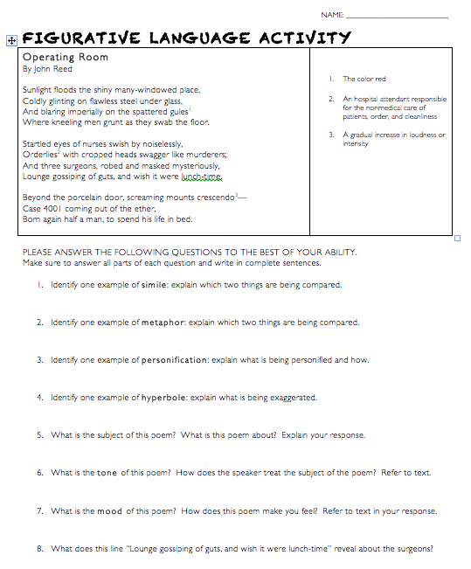
FIGURATIVE LANGUAGE ACTIVITY EXAMPLE

Slide 11
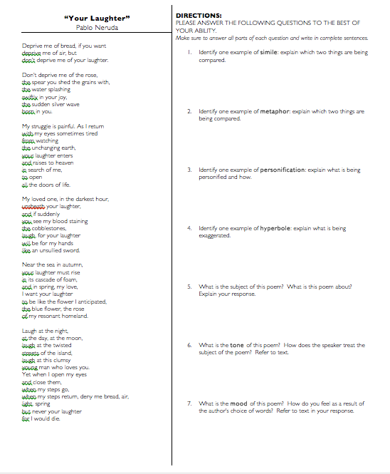
FIGURATIVE LANGUAGE ACTIVITY INDIVIDUAL
DIRECTIONS:
CLOSE-READ THE POEM
ANSWER QUESTIONS

Slide 12
EXIT TICKET
On a piece of scratch paper...
Improve the following sentences:
[metaphor] She was pretty.
[simile] He was excited.
[hyperbole] I was hungry.
[personification] The wind made a noise.

