Slide 1
TO DO
Enter homework grades
Organizing your essay activity handout
Example paragraph
Close read
Half Sheet with the 4 Questions for their own stories?
Write questions on the board
How do they select evidence?
Update board

Slide 2
DO NOW
STANDARD
OBJECTIVES
Analyze how an author's choices concerning how to structure a text, order events within it (e.g., parallel plots), and manipulate time (e.g., pacing, flashbacks) create such effects as mystery, tension, or surprise.
Create a CEL paragraph that analyzes how Malcolm X uses story structure in “Learning to Read” to create mystery, tension, or surprise.

Slide 3
AGENDA
Business
Structure Notes
Structure Activity
CEL Paragraph
Exit Ticket

Slide 4
GOALS TODAY
STANDARD
OBJECTIVES
Analyze how an author's choices concerning how to structure a text, order events within it (e.g., parallel plots), and manipulate time (e.g., pacing, flashbacks) create such effects as mystery, tension, or surprise.
Create a CEL paragraph that analyzes how Malcolm X uses story structure in “Learning to Read” to create mystery, tension, or surprise.

Slide 5
HOMEWORK & PREVIEW
HW Tonight
Next Class Connection
“4 Questions for Structure”
Typed CEL Paragraph
You’ll use your answers to help create your plot diagram next class period.

Slide 6
SET-UP
Pen/Pencil
E-Books
iPads
“Learning to Read” – Malcolm X

Slide 7
UPDATE: UNIT 1 TABLE OF CONTENTS!
PG #
Personal Narrative Table of Contents
14
Project Rubric Analysis
15
W.10.3A – Engage/Orient
16
RL.10.5 – Analyzing Author’s Structure
17
Plot Diagram
18
RL.10.5 – Structure Notes
Notes:
TELL THEM TO WRITE THE CORRECT PAGE NUMBER (it might be different)
SWITCH TO ELMO
DRAW FOR THEM
Add two pages
Plot Diagram Notes
Plot Diagram Example

Slide 8
NOTES
8/14
RL.10.5
Today I will be learning…
Today I will be creating…
STRUCTURE NOTES:

Slide 9
NOTES
CHRONOLOGICAL/LINEAR:
Events arranged as they occur
Lincoln

Slide 10
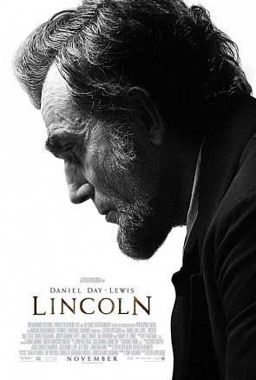
CHRONOLOGICAL / LINEAR

Slide 11
NOTES
CHRONOLOGICAL/LINEAR:
Events arranged as they occur
REVERSE CHRONOLOGICAL:
Plot revealed in reverse order (ending first).
Lincoln
Eternal Sunshine of the Spotless Mind

Slide 12
NOTES
CHRONOLOGICAL/LINEAR:
Events arranged as they occur
REVERSE CHRONOLOGICAL:
Plot revealed in reverse order (ending first).
NON-LINEAR:
Out of sequence story.
Lincoln
Eternal Sunshine of the Spotless Mind

Slide 13
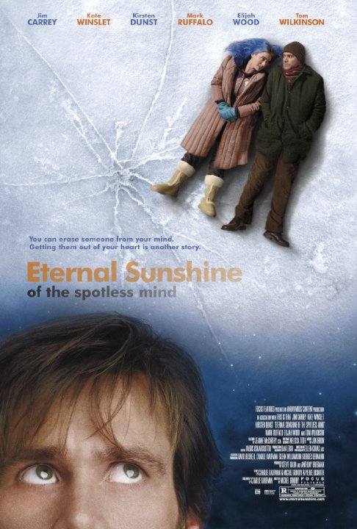
REVERSE CHRONOLOGICAL & NON-LINEAR NARRATIVE
https://www.youtube.com/watch?v=0BK6NH81mbs

Slide 14
NOTES
CHRONOLOGICAL/LINEAR:
Events arranged as they occur
REVERSE CHRONOLOGICAL:
Plot revealed in reverse order (ending first).
NON-LINEAR:
Out of sequence story.
FRAMED (in media res):
Story within a story.
Lincoln
Eternal Sunshine of the Spotless Mind
Forrest Gump

Slide 15
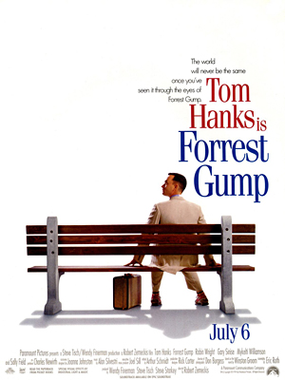
FRAMED
https://www.youtube.com/watch?v=8dcYw4OwCA0

Slide 16
NOTES
CHRONOLOGICAL/LINEAR:
Events arranged as they occur
REVERSE CHRONOLOGICAL:
Plot revealed in reverse order (ending first).
NON-LINEAR:
Out of sequence story.
FRAMED (in media res):
Story within a story.
EPISTOLARY:
Documents used to tell story (ex: letters, journal entries)
Lincoln
Eternal Sunshine of the Spotless Mind
Forrest Gump
The Notebook

Slide 17
EPISTOLARY
https://www.youtube.com/watch?v=4M7LIcH8C9U

Slide 18
Teacher Slide TEXT WARM-UP
Oscar Wao Example
Plot Diagram (?)
Reading Questions
Student Application
Plot Diagram
Reading Questions

Slide 19
QUESTION
Why would someone choose to tell a story in a non-linear way?
Think of it this way…

Slide 20
DIFFERENT APPROACHES
1.
I was melancholy because my dog died last Monday.
2.
The melancholy had taken ahold of me. I could still feel the sorrow I experienced when tragedy struck last Monday.
Notes:
Pretend this is the opening sentence of my story.
What information is mission in response two?
If you had never read option 1, why would you keep reading the story beginning in option 2?

Slide 21
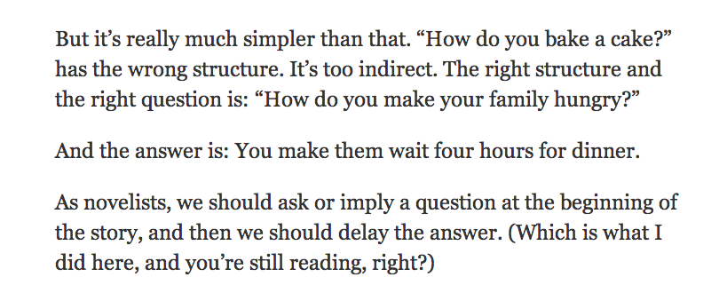
The Answer? BECAUSE IT’S MORE ENTERTAINING IF YOU’RE LEFT GUESSING or WONDERING!
Check out this excerpt. Written by the man who created the Jack Reacher series…
He was asked – “How do writers create suspense?”

Slide 22
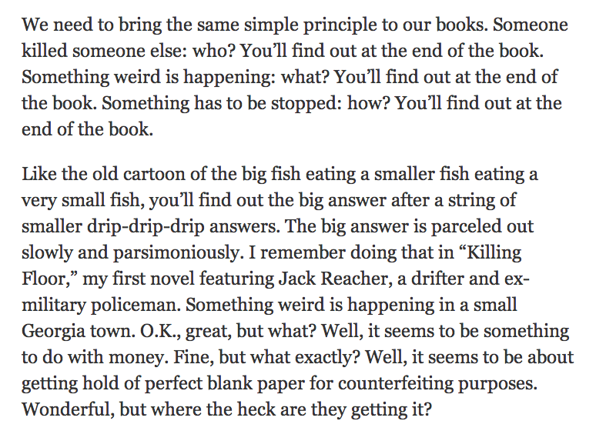

Slide 23
BUT HOW DO WE LEAVE THE READER QUESTIONING?

Slide 24
WARM UP [TEACHER EXAMPLE]
Answer the following questions:
What is the main conflict/problem/event?
What organization structure has the author selected?
What is the solution or resolution of the story?
What important information do we learn that helps make the resolution more satisfying?
Notes:
1. Oscar Wao – He wants to be a fantasy hero (with all that entails… love, heroics, thrill, etc)
2. Non-Linear – The story jumps around, which is why some students got frustrated or lost
3. Oscar finds his self-proclaimed true love and dies what he would probably deem a hero’s death.
4. His death wouldn’t seem so heroic if we didn’t know all the backstory of his family and that the struggles which followed him, were actually the struggles of generations and years. When you think of it this way, his death really does seem like a story he would have tried to write.
Junot Diaz does NOT want you to know that Oscar will die at the beginning… at least not before you know everything his family has been through. It makes his death more powerful. He tells the story out of order so we get all the information included in the rising action.

Slide 25
YOUR 1st TASK:
On a sheet of notebook paper:
Create a plot diagram for “Learning to Read” by Malcolm X
Answer the analysis questions

Slide 26
CEL PARAGRAPH TASK
Create a CEL paragraph that analyzes how Malcolm X uses story structure in “Learning to Read” to create mystery, tension, or surprise.

Slide 27
EXAMPLE CEL PARAGRAPH

Slide 28
CEL PARAGRAPH
CLAIM | What is the plot structure? What is the outcome?
EVIDENCE | Where does your quote occur in the text? What is the quote?
LINK | LOOK AT THE READING QUESTIONS YOU COMPLETED EARLIER! How can you weave these answers together?

Slide 29
CEL Paragraph

Slide 30
Homework and Post-CEL Paragraph Activity

Slide 31
IF NECESSARY:
Have students begin to plan their own plot diagram.
Answer the four questions
Start creating the plot diagram

