Slide 1
TO DO
Assign groups
Copies of activity sheet
Copies of quiz, just in case
More copies of reading packet
Name Cards
Seating Charts for honors
List of students for tutoring

Slide 2
DO NOW
TAKE OUT:
DO THIS:
Frankenstein Book
Reading Packet
E-Book
Pen/Pencil
iPad
Reading Packet out and open to HW
Review for On-Time Quiz
Letters 1-4

Slide 3
AGENDA
Announcements
Practice On-Time Quiz
“What is Knowledge?”
Teacher Model
Student Activity
Exit Ticket

Slide 4
OBJECTIVES
Internalize expectations for On-Time Quizzes by successfully completing a practice quiz on Socrative.com.
Use graphic organizes to create a successful definition of human intelligence that references what is learned from your Pearson audio recording.

Slide 5
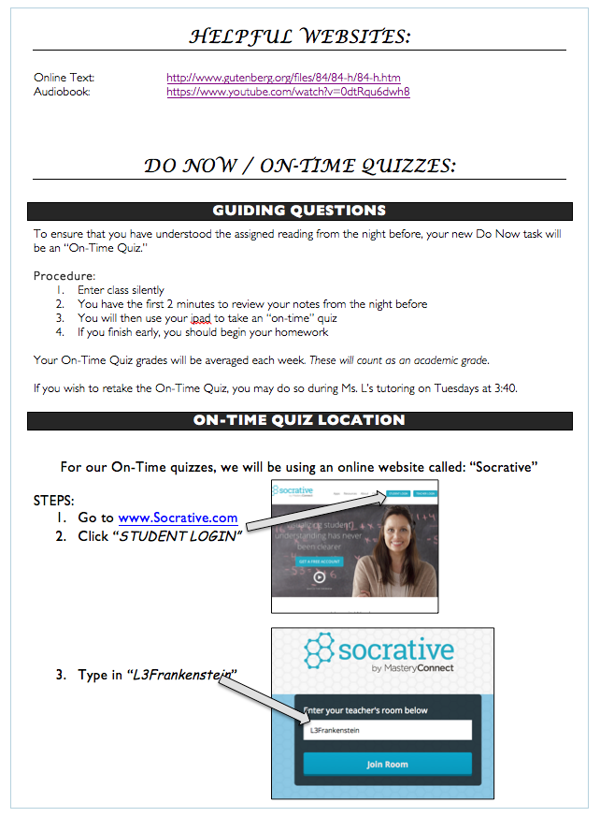
Do-Now / On-Time Quizzes

Slide 6
PRACTICE On-Time Quiz
Today’s on-time quiz will not count towards your grade
Practice!
All upcoming On-Time Quizzes will be averaged on a weekly basis and entered as an academic grade.
Thurs/Fri will be averaged with next week
As you take this practice quiz, please have your packet out, so I can give you a sticker for completed work.

Slide 7
ON-TIME QUIZ DIRECTIONS
STEP 2
STEP 1: www.socrative.com

Slide 8
“L3Frankenstein”

Slide 9
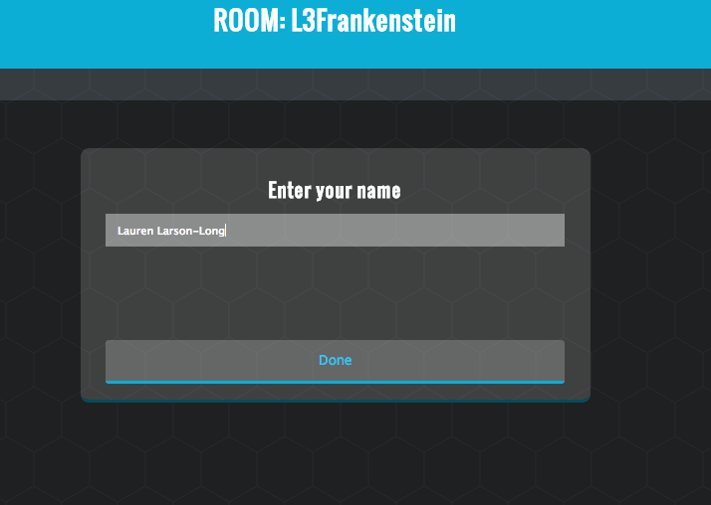
FIRST
&
LAST NAME!

Slide 10
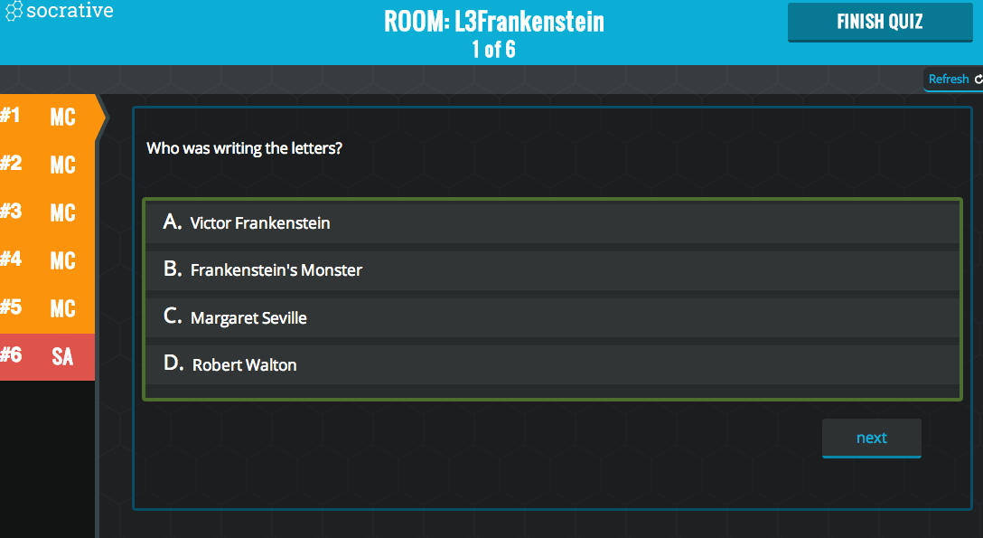

Slide 11
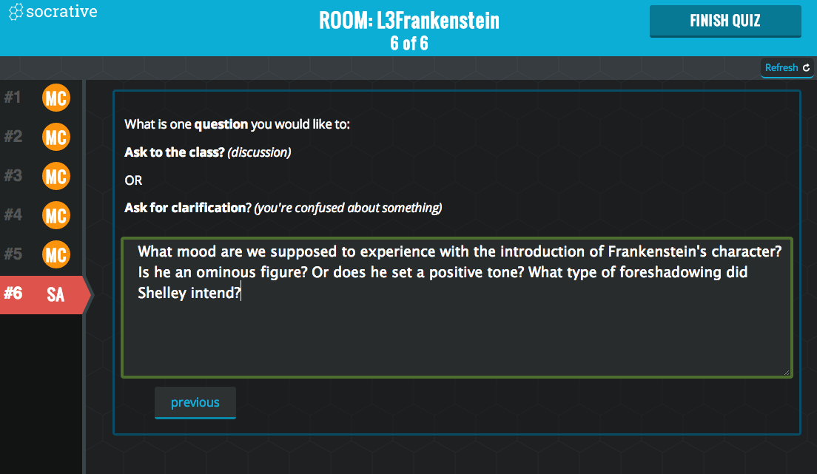

Slide 12
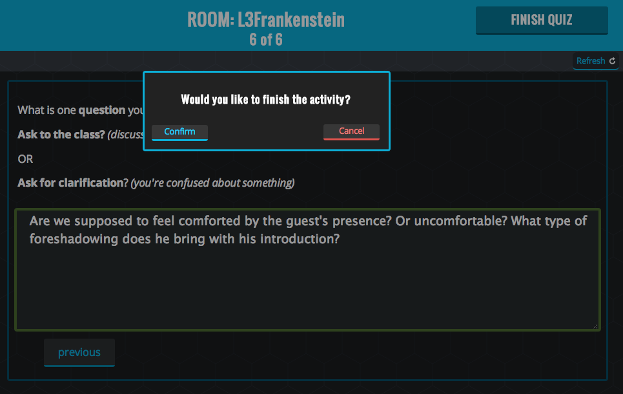

Slide 13
Review of Quiz
Who was writing the letters?
To whom are the letters written?
Where is the writer and why is he there?
How does Robert feel about Dr. Frankenstein?
At the end of Letter 4, what does Frankenstein say he will do the next day?

Slide 14
5 Minute Updates
Update your timeline of events
Be strategic… this has to last for the whole novel
Update your character list (if necessary)

Slide 15
Project Prompt:
Of the robots and creatures we have read about during this unit, which one is the most human? In your essay you should create a precise and insightful definition of what it means to be human (thesis) and then effectively defend your response with evidence from our unit texts (body).

Slide 16
What is intelligence?
Your essay definition answers “what does it mean to be human?”
Part of humanity is intelligence
You may want to include this idea in your essay…

Slide 17
YOUR INDIVIDUAL TASK
All of you have been assigned an audio clip
Next class, you will be placed in small groups
Share findings → Small group presentations

Slide 18
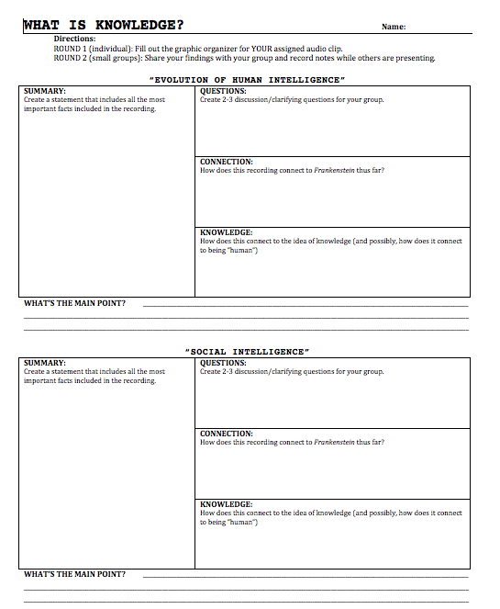
YOUR INDIVIDUAL TASK

Slide 19
TEACHER EXAMPLE
OUR QUESTION → “What is intelligence?”
Ted Talk with Henry Markram:
https://www.youtube.com/watch?v=oYqXQw2CryI

Slide 20
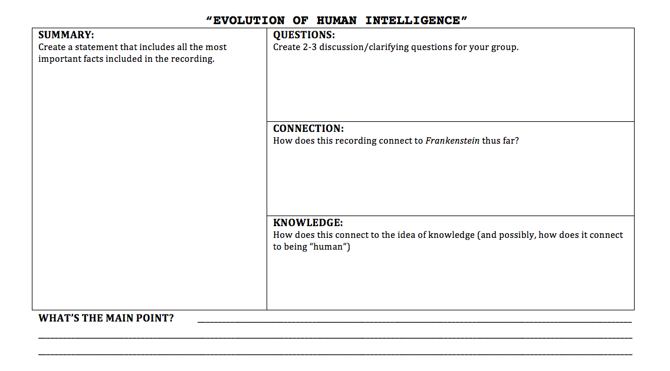
YOUR INDIVIDUAL TASK
Notes:
Take the notes from the whiteboard and transfer them to this sheet of paper.

Slide 21
YOUR INDIVIDUAL TASK

Slide 22
HOMEWORK
Chapters 1-2
Packet Chapters 1-2

Slide 23
EXIT TICKET
Based on YOUR audio recording today, create an original definition of human intelligence.

