Slide 1
In the morning
Update board
Copies
Seating charts?
Name card updates?
Print rosters for HW
Do Now

Slide 2
DO NOW: 5min
Please use your iPad to take a SELFIE.
Please attach to an email message and send to:
L3StudentProjects@gmail.com

Slide 3
AGENDA
Business
Unit Set-Up
Project Overview
“Shooting an Elephant” Activity
Exit Ticket

Slide 4
BUSINESS
GOAL:
Quizzes and summer reading assignments will be handed back next class period!
Bathroom policy
[See poster at the front of the room]
New seating charts next week.
Last chance to privately let me know who you can’t sit next to!

Slide 5
HOMEWORK
“Object” Research!
[will be explained later in the period]

Slide 6
HW Policy (for now)
THE POSITIVE!
During appropriate exit tickets, you may listen to music on all days that HW is submitted (with headphones and iPads only).
the negative…
5 MIN after class: Day of
TELEPARENT: More than 1 missed HW during the week

Slide 7
DO NOW: STANDARD & OBJECTIVES
STANDARD | OBJECTIVE
CCSS.ELA-LITERACY.W.9-10.3.A Engage and orient the reader by setting out a problem, situation, or observation, establishing one or multiple point(s) of view, and introducing a narrator and/or characters; create a smooth progression of experiences or events. | Use graphic organizers to identify the purpose of literary techniques in a fiction/non-fiction narrative and write descriptions that analyze how these engage and orient the reader.

Slide 8
WELCOME TO YOUR NEW UNIT!
Setting up your E-Book for
UNIT I: PERSONAL NARRATIVE!

Slide 9
Table of Contents
PG #
Table of Contents
Directions:
Skip 3 pages (just in case we need to add something later)
Write:
“Unit 1: Personal Narrative Table of Contents”
PG: 13
2
Expectations, Grades, and Late Work
3
Entrance and Do Now
4
Group Roles
5
Discussion Starters
6-7
Sentence Starters
8
CEL Paragraph
9
Close Reading Strategy
10
11
12
13
Unit 1: Personal Narrative Table of Contents

Slide 10
PG #
Personal Narrative Table of Contents
14
Project Rubric Analysis

Slide 11
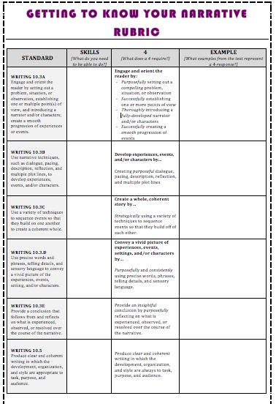
Rubric
Glue your rubric to the BACK of your table of contents.

Slide 12
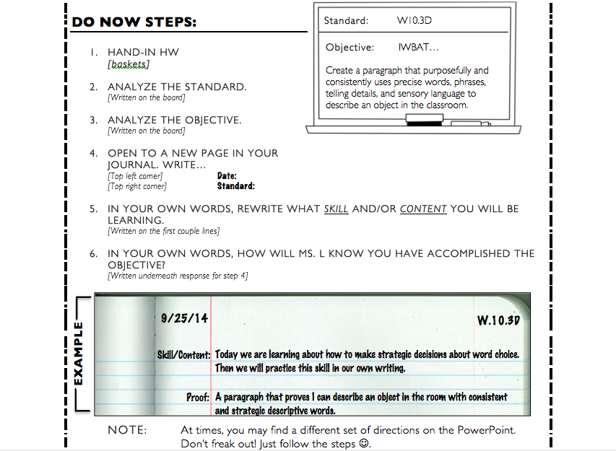

Slide 13
Practice DO NOW: STANDARD & OBJECTIVES
Use E-Book example if you’ve forgotten what to do!
STANDARD | OBJECTIVE
CCSS.ELA-LITERACY.W.9-10.3.A Engage and orient the reader by setting out a problem, situation, or observation, establishing one or multiple point(s) of view, and introducing a narrator and/or characters; create a smooth progression of experiences or events. | Use graphic organizers to identify the purpose of literary techniques in a fiction/non-fiction narrative and write descriptions that analyze how these engage and orient the reader.

Slide 14
DO-NOW: Let’s Discuss!
What skill or content do you think we will be learning?
How will Ms. L know you have accomplished the objectives?

Slide 15
SET-UP
“Shooting an Elephant”
Annotation tools
iPad
Then go to this link!
http://www.corestandards.org/ELA-Literacy/W/9-10/

Slide 16
First Unit: Narrative… but why?

Slide 17
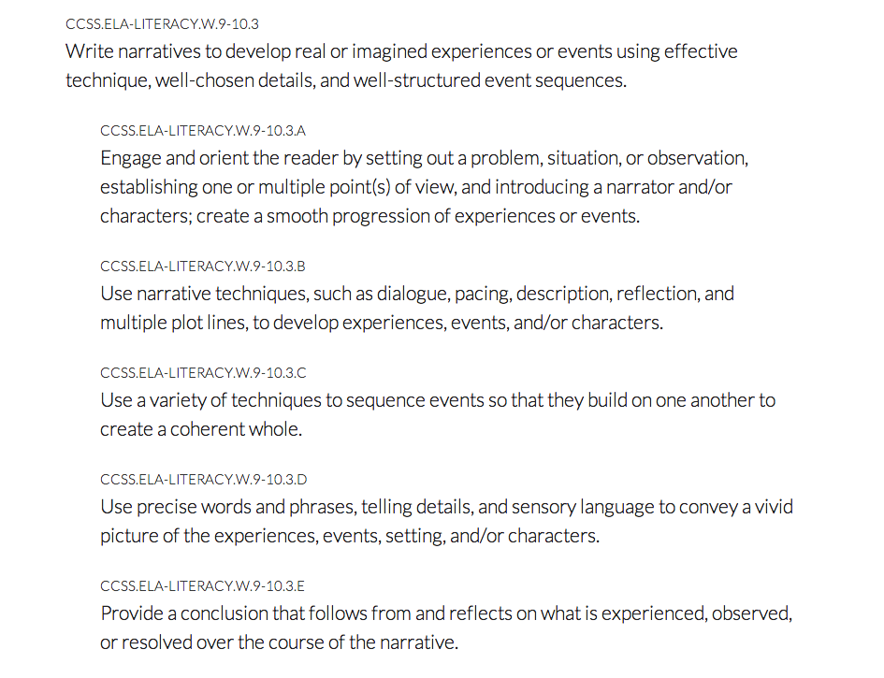

Slide 18
What is a Narrative?
https://www.youtube.com/watch?v=mj-eh5VFsg0
(ignore the goofiness)

Slide 19
PROJECT EXPLANATION!
[switch to Elmo]
Please mirror my annotations!
Write down any questions you might have!
Notes:
Annotate the prompt
Read
Underline
Turn into a question
Introduce the grading rubric
Analyze the wording of the first standard
Tie back to the objective

Slide 20
TEACHER SLIDE: Project
Annotate the prompt
Read
Underline
Turn into a question
Introduce the grading rubric

Slide 21
TEACHER SLIDE: Elephant
Analyze the wording of the first standard
Look up definition on dictionary.com
Tie back to the objective
Reading Comprehension questions
Examine short story as class
Do an example together

Slide 22
TEACHER SLIDE: Elephant
Point out examples
Why is it important? What would we miss out on? (look at table on handout)
Have them work with their partner

Slide 23
ENGAGE/ORIENT
ENGAGE | ORIENT
Ways to engage: Why do you care about a character? What suspense has been added? Why do you want to discover more about what’s going on? | Ways to orient: Names of characters Descriptions of characters Setting What is the issue/problem Background/context
Notes:
Engage:
“I was hated by large numbers of people”
“When a nimble Burman tripped me up on the football field and the referee (another Burman) looked the other, the crowd yelled with hideous laughter.”
Orient:
“I was the sub-divisional police officer of the town, and in an aimless, petty kind of way anti-European feeling was very bitter.”

Slide 24
5 MINUTE BREAK!!!

Slide 25
EXIT TICKET - Alternate
Once you have finished your close-reading activity, please pick 1 piece of text (from EITHER “Shooting an Elephant” or “Breaking Through” to use for your project rubric example.

Slide 26
EXIT TICKET
CLOSE READ the first two paragraphs of “Breaking Through” on pg 4.
Find:
1 example of how the author ENGAGES
1 example of how the author ORIENTS

